Slide 1

KIET Group of Institutions, Ghaziabad
Training And Placement Process Automation
Group ID: PCSE25-63
Students Name: Shubham Verma, Abhishek Kumar Rai
Semester : 8
Department: Computer Science and Engineering
Name of Project Guide : Prof. Gaurav Parashar
Date of Presentation : 24/05/2025
1

Slide 2
KIET Group of Institutions, Ghaziabad
Problem Statement
The traditional Training and Placement (TnP) process in educational institutions is often fragmented, manual, and inefficient. Placement officers manage large volumes of student data, company requirements, eligibility criteria, and placement schedules using spreadsheets or isolated tools, leading to:
Time-consuming coordination between students, TnP staff, and recruiters
Lack of transparency in application status, shortlisting, and result announcements
Manual errors in eligibility checks, documentation, and reporting
Difficulty in tracking placement metrics and generating analytics for institutional improvement
To address these challenges, there is a need for a centralized, automated system that streamlines the end-to-end placement process, ensures real-time updates, and enables seamless communication between all stakeholders.
2

Slide 3
KIET Group of Institutions, Ghaziabad
Solution
To address the inefficiencies in the traditional placement process, we developed TnP Automation, a centralized web-based platform that:
🔹 Centralizes Placement Activities
Unifies all placement-related tasks—registrations, eligibility checks, job postings, and applications—on a single dashboard.
🔹 Automates Workflows
Automatically filters eligible students based on criteria (e.g., CGPA, branch).
Sends real-time notifications and reminders to students and administrators.
🔹 Enhances Transparency & Tracking
Provides live status tracking of applications, interviews, and offer letters.
Generates detailed reports on placement statistics for insights and audits.
🔹 Enables Role-Based Access
Secure, role-specific logins for students, TnP officers, and recruiters.
Ensures data privacy and reduces manual errors.
🔹 Improves Communication
Built-in messaging system for seamless communication between all stakeholders.
Minimizes dependency on external tools like email or WhatsApp.
3

Slide 4


TnP Automation: Placement Monitoring System
This presentation will introduce you to the TnP Automation system We developed. It is a centralized platform for managing the entire placement process. The system was built to enhance efficiency, transparency, and collaboration within the placement ecosystem.

Slide 5
Purpose: Centralized Placement Management
Streamlined Process
Real-Time Visibility
The TnP Automation system simplifies placement tracking, eliminating manual data entry and reducing administrative overhead.
All stakeholders—students, departments, CRPC, and recruiters—can access updated information instantly.

Slide 6

Key Modules
Student Module
Department Module
Students can create profiles, upload resumes, apply for jobs, and track their progress.
Department module tracks students' progress, monitors placement status, and compares data with previous years for insights.
CRPC Module
Recruiter Module
The CRPC can monitor placement activities, analyze data, post job and generate reports.
Recruiters can access candidate profiles and post new jobs.

Slide 7

Student Module
Profile Management
Job Application
Students can manage their profile information, including resumes, skills, and academic records.
Students can apply for jobs based on their interests and qualifications.
Progress Tracking
Students can view their application status, interview schedules, and placement updates.

Slide 8

Department Module
1
Placement Insights
2
Placement Coordination
Teachers can track the current placement status of students. Access and analyze placement data from previous years.
Departments can coordinate placement activities with the CRPC and recruiters.

Slide 9




CRPC Module
Placement Analytics
The CRPC can track placement statistics, analyze trends, and identify areas for improvement.
Reporting
The CRPC can generate reports for various stakeholders, providing insights into placement performance and trends.
Placement Calendar
The CRPC can manage the placement calendar, scheduling events, job posts and deadlines.

Slide 10

Recruiter Module
Candidate Search
Placement Decisions
Recruiters can search and filter candidate profiles based on skills, experience, and other criteria.
Recruiters can make placement decisions and communicate with candidates.
1
2
3
Interview Scheduling
Recruiters can schedule interviews with shortlisted candidates.

Slide 11




Tech Stack
Node.js
1
The system is built on Node.js, a powerful JavaScript runtime environment.
EJS
2
EJS provides dynamic templating capabilities for creating user interfaces.
MongoDB
3
MongoDB serves as the database, providing efficient storage and retrieval of data.
Cloudinary
4
Cloudinary enables easy management and optimization of images.

Slide 12

Impact
20%
Improved Efficiency
The system has significantly improved the efficiency of the placement process, reducing time spent on manual tasks.
50%
Increased Transparency
The system provides real-time visibility into placement activities, fostering transparency and trust among stakeholders.
90%
Enhanced Collaboration
The system facilitates seamless collaboration between students, departments, CRPC, and recruiters.

Slide 13
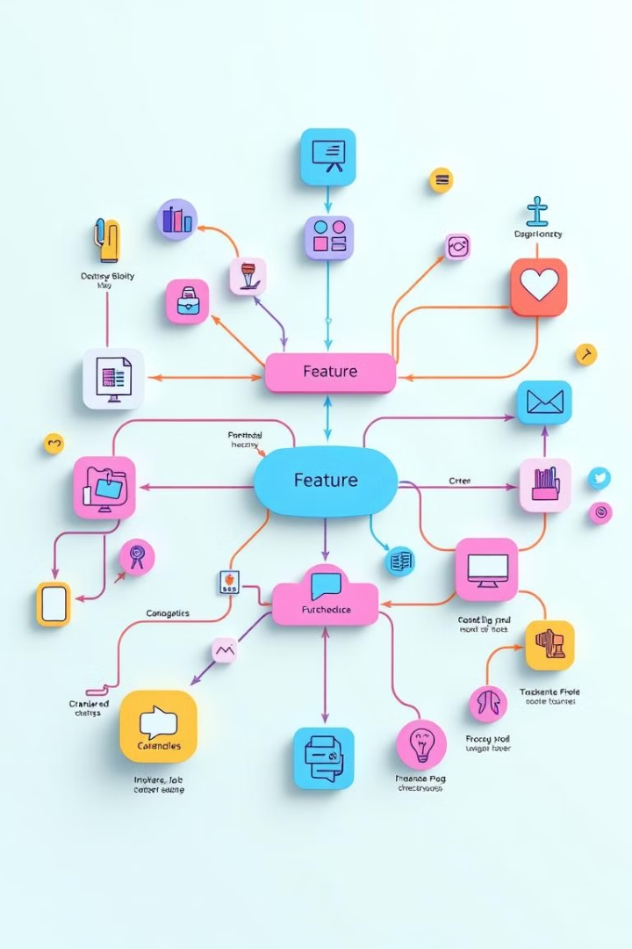
Future Development
The TnP Automation system is a living project, constantly evolving to meet the changing needs of the institution and its stakeholders.
Future development efforts will focus on enhancing the system's functionalities and improving the user experience.

Slide 14


